Slide 1


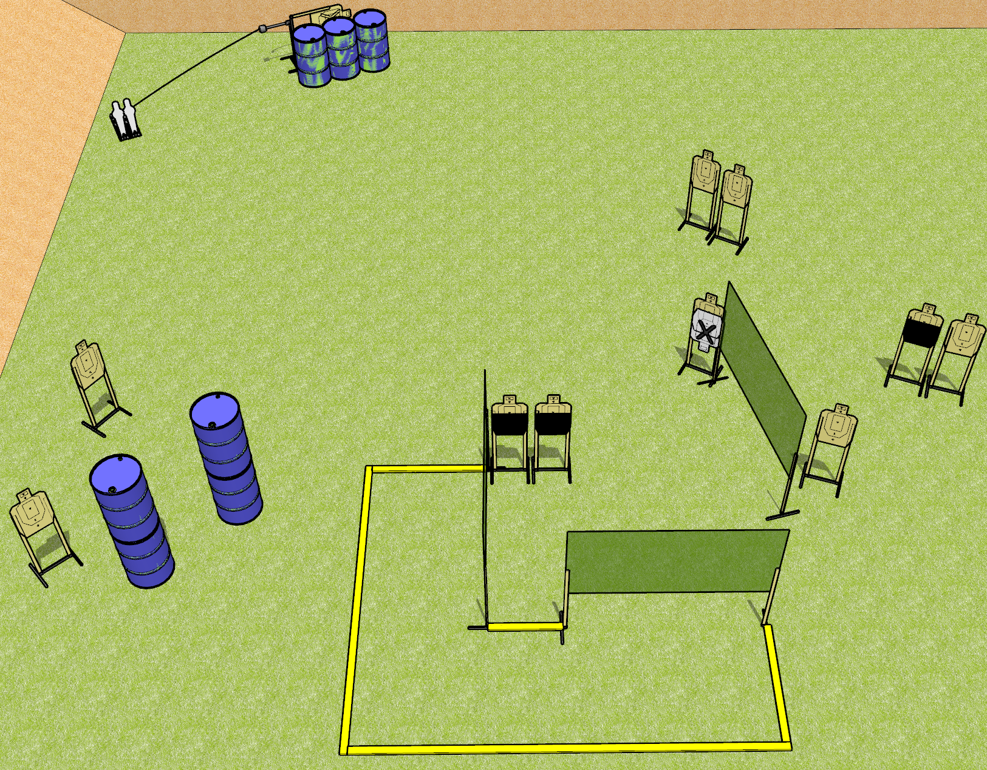
 | Dothan Gun Club – USPSA Match Chicken Little Course Designer : Drew Coleman
24 rounds 11 USPSA 2 mini poppers
Equipment List 6 wall feet 1 swinger + activator Make the hard cover show 1/3 of the lower A-zone

Slide 2
Chicken Little
Written Stage Briefing
Chicken Little is a 24 round, 120 point, Comstock course of fire. There are 11 USPSA targets and 2 USPSA mini poppers. The best 2 hits on paper will score, and steel must fall to score. The start signal is audible.
The swinger is activated by either popper. Please check the activator prior to walkthrough and set it the same way every time.
Handgun start position is outside the shooting area, heels against the most downrange fault line, wrists above shoulders. Handgun is loaded and holstered.
PCC start position is outside the shooting area, heels against the most downrange fault line. Loaded carbine is held with both hands, stock on belt, safety on.
On start signal, engage targets as they become available from within the shooting area.

